Slide 1
Flappy bird - clone
DATA STRUCTURES PROJECT
Submitted By:
Manav Agrawal (2K19/CO/216)
Kritesh Rauniyar (2K19/CO/196)
Submitted to:
Mrs. Daya Gupta Maam

Slide 2
introduction
We developed a game Flappy Bird in which a player needs to avoid obstacles (pipes) while staying in air, which is done by pressing space bar or Up arrow key.
This game will never end until and unless player crashes to a obstacle.
The Game runs as follows:
The Starting Page appears which just reminds to get ready to play the game.
Now, Game runs until the player crashes to a pipe or any surface.
The Ending Page appears now displaying the score made by the player.
Once you die by colliding to any surface you can replay the game by just pressing the SpaceBar or Up arrow Key.
The game can be exited by pressing the Escape Button or clicking the Quit. Otherwise, once started the game can be played any number of times.

Slide 3
SOFTWARES USED
Code Editor : Visual Studio Code IDE
Language : Python
Modules:
Pygame : Pygame is a cross-platform set of Python modules designed for writing video games. It includes computer graphics and sound libraries designed to be used with the Python language.
Sys : It is used for exiting the game in our project.
Random : It is used for generating random pipes ( obstacles ) in our project.
Time : It is used for time delay for screen in our project.

Slide 4
Workflow of the game
Loading of assets as global variable to the program.
starting_page(): # Displaying starting page
Initialisation of background and welcome message.
Conditions to play or Quit the game.
game_main():
Initialisation of game elements such as background, pipe’s creation, velocity and player’s position, velocity and acceleration.
random_generate_pipe(): Generation of pipes randomly using random module.
Getting input from the player as player plays and displaying the score as the player proceeds.
If the player passes the pipe, the score is increased.
Detecting_crash: collision_test() - A function to test if the player has crashed to a surface and exit game if ‘true’.
endgame(): The end page is displayed with the final score, medal earned and best score till date is created.
To play again press Space and to exit press Escape or Click Quit.

Slide 5
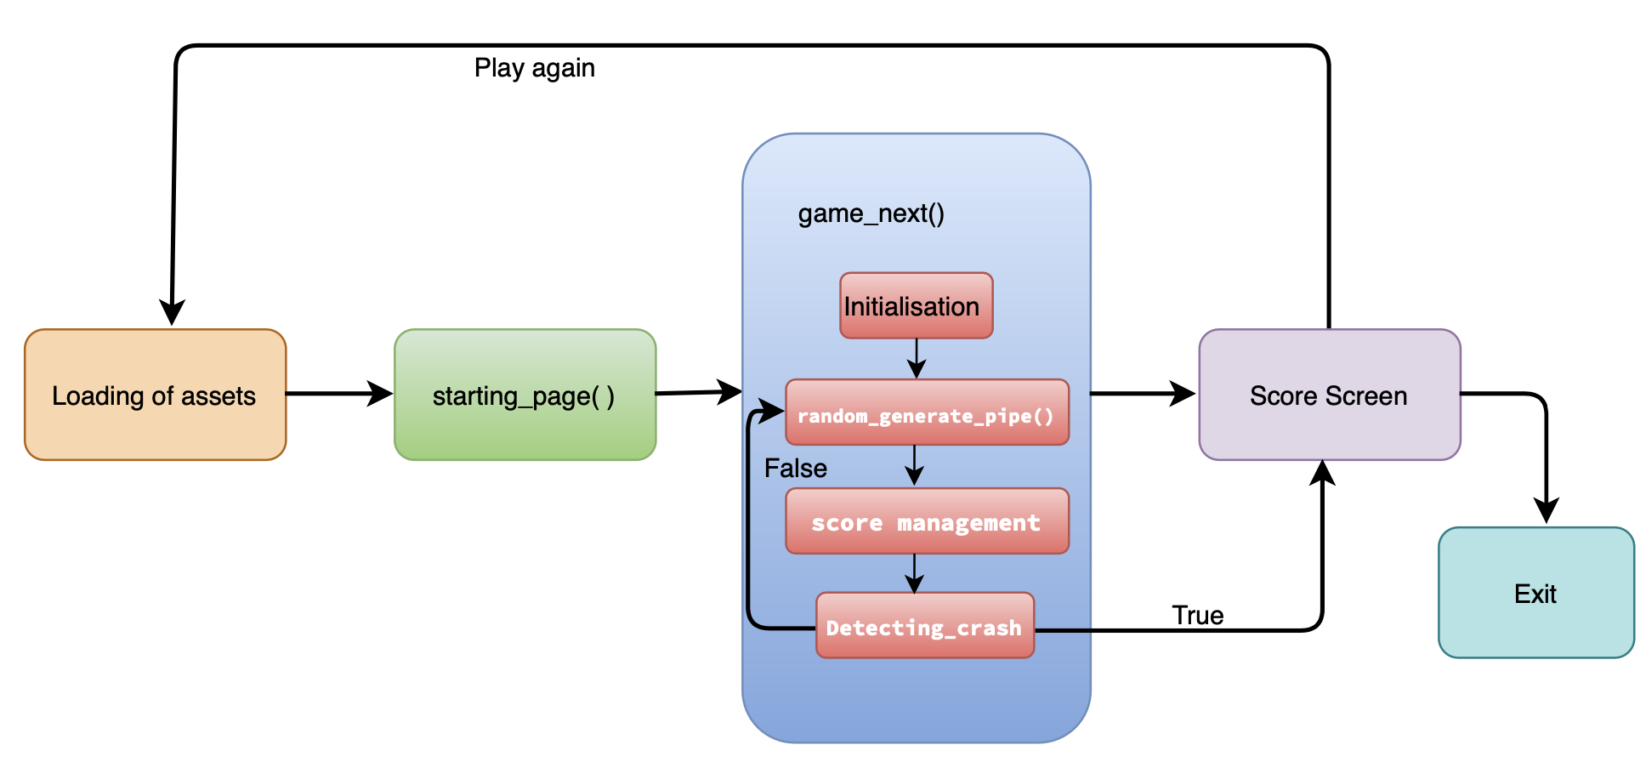
BLOCK DIAGRAM

Slide 6
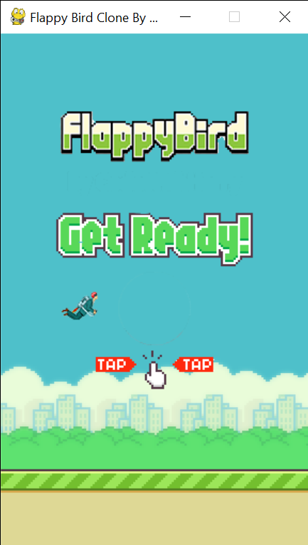
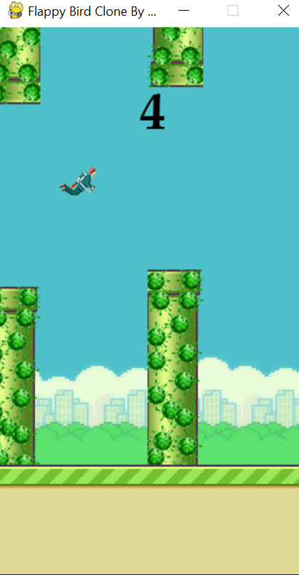
SNAPS OF THE GAME
Fig: Starting Page
Fig: Playing mode

Slide 7
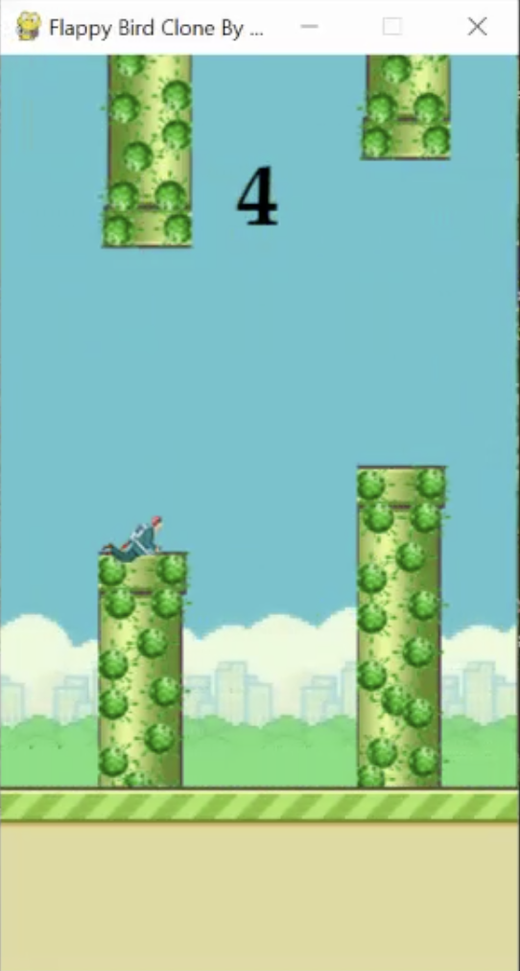
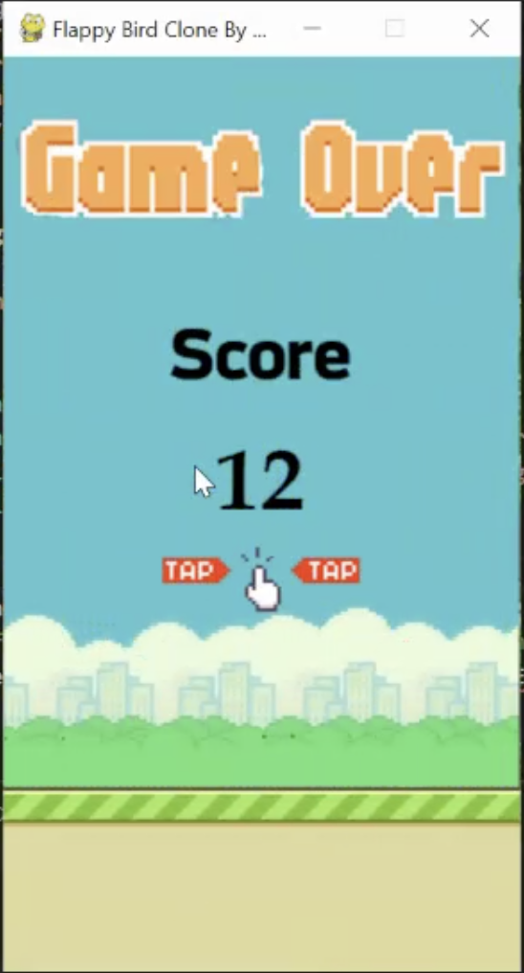
SNAPS OF THE GAME
Fig: Colliding with obstacle
Fig: Final Score

Slide 8
THANKS!
THANKS!

